Slide 1
SAGE
Gameful Affinity Space
Learning Metrics
Final Presentation
Bicheng Jiang, Jiaying Yang, Lillian Zha

Slide 2
Objective:
Implement features to present teachers and students with metrics/visualizations of personal and class performance in the SAGE affinity space

Slide 3
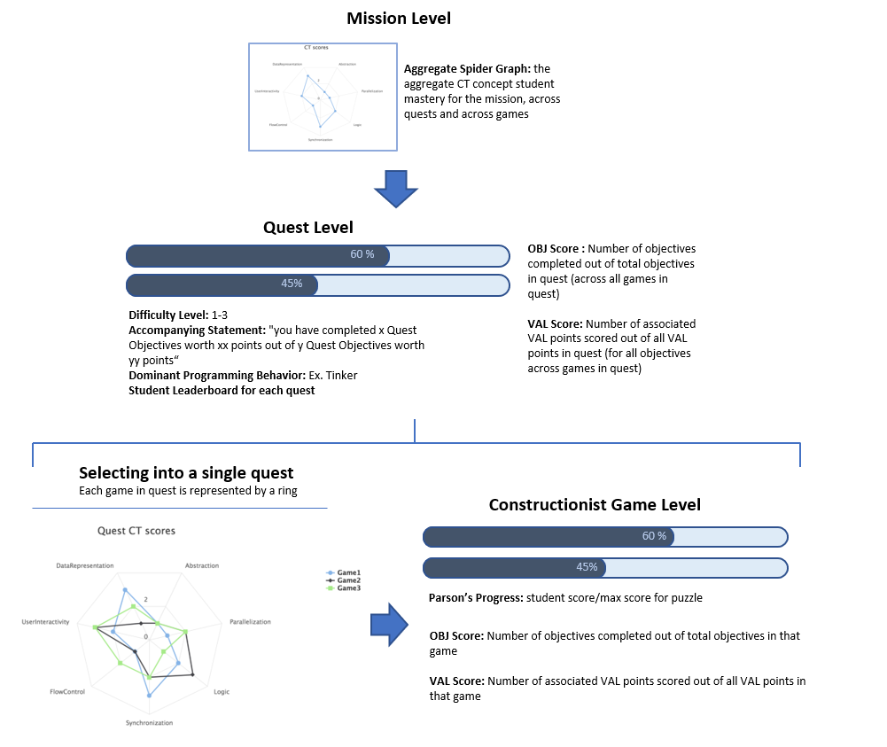

Slide 4
Student Interface
Created a Metrics page where student can view full summary of their performance
Game Level | Quest Level | Mission Level
Progress bar showing number of objectives completed in game Progress bar showing points earned in game Spider graph showing concept mastery | Progress bar showing number of objectives completed in quest Progress bar showing points earned in quest Spider graph showing concept mastery across games Badge associated with quest creation | Spider graph showing concept mastery across quests in mission Badge library associated with awards earned from mission

Slide 5
Teacher Interface
By Student | By Class
For each student, a teacher can view his/her concept mastery across quests in a mission | Teachers can see how each class is performing overall in an aggregate spider graph showing average CT scores of the class across missions
Upon creation of a quest, a teacher can also associate a badge with that quest and customize its icon, requirement and description

Slide 6
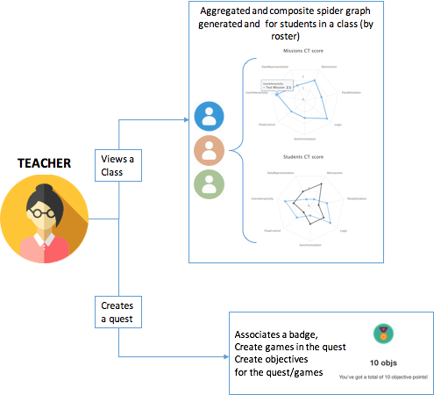
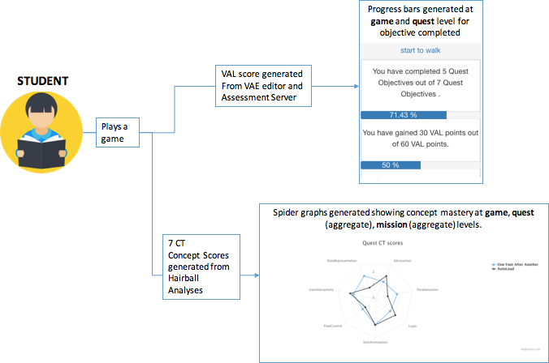
Data Model/Architecture

Slide 7
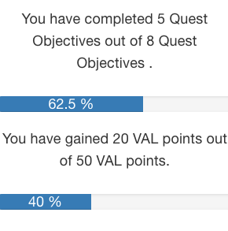
Progress bars
2 types of progress bars:
Measures percentage objectives completed
Measures percentage VAL points earned
The combination of these two metrics show how well a student has performed according to the teacher’s goals for the game or mission

Slide 8

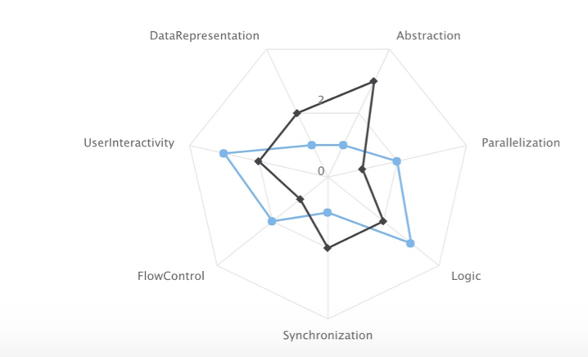
Spider graphs
Implemented through HighCharts api
Aggregate and Composite spider graphs on teacher and student side
Display mastery of 7 CT concepts:
Abstraction, parallelization, logic, synchronization, user interactivity, data representation, flow control
CT score ranges from 0-3

Slide 9
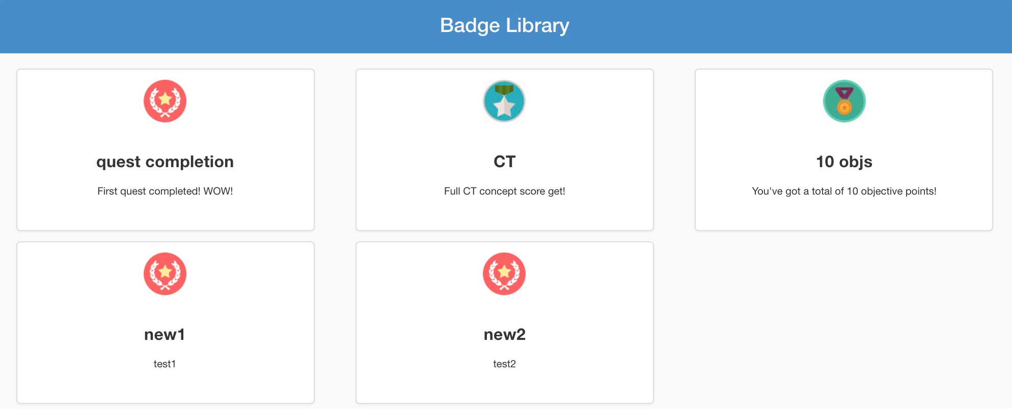
Badge Library
Basic badge library implementation
Badge creation (through quest creation) by teacher
Badge collection: icon url, badge name, issuer name, badge description, requirement

Slide 10

Future Work
leaderboard - implementation of leaderboard by quest for each class
more gamification - include more student-friendly terminology when displaying scores
badgr.io api - only recently discovered how to use api, will provide documentation
transition to material framework - gradually change front-end to be more aesthetically cohesive

